Slide 1

REALTIONSHIP IN CLASSES

Slide 2
When we create two or more classes and establish relationships between them, the study of those relationships is called class relationships.
Class a{
}
Class b {
}

Slide 3
Two types of relation:
1-Inheritance
2-Associtaion
Inheritance : Inheritance is a property of parent class to child class.
When we do changes in one class then these properties also inherits in another class.

Slide 4
SYNTAX:
CLASS A {
}
CLASS B EXTENDS A {
}
TYPES OF INHERITANCE
1-SINGLE INHERITANCE
2- MULTI –LEVEL INHERITANCE
3-HIERARCHICAL INHERITANCE
4-MULTIPLE INHERITANCE

Slide 5
Single inheritance: Single inheritance is nothing but which contains only one super class and only one sub class is called single inheritance.
Syntax:
class A{
}
public class B extends A{
}

Slide 6
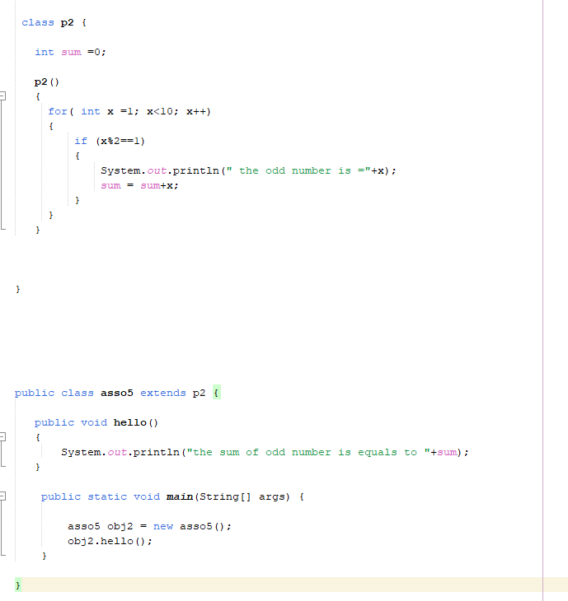

Slide 7
Multi-level inheritance : in multilevel inheritance we have only one super class and multiple sub classes called multi-level inheritance.
Syntax:
class a {
}
class b extends a{
}
public class c extends b {
}

Slide 8
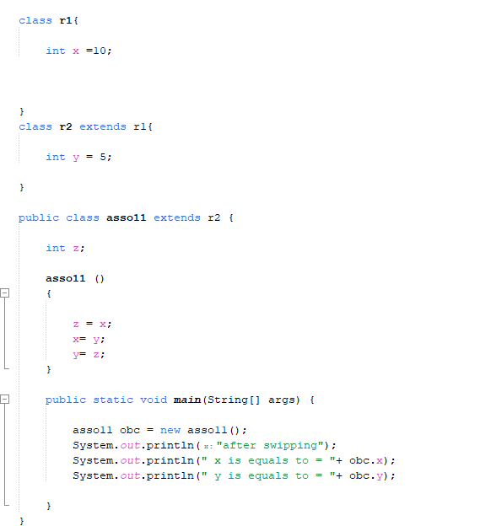

Slide 9
Hierarchical inheritance :a inheritance which contain only one super class and multiple sub classes and all sub classes directly extends super class called hierarchical inheritance.
Syntax
class a {
}
class b extends a {
}
Public class c extends a{
}

Slide 10
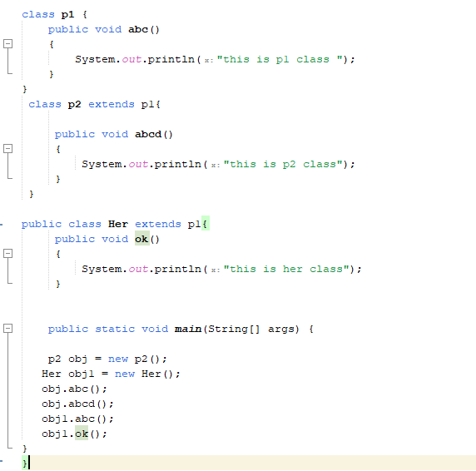

Slide 11
Multiple inheritance : not support in java we use it with the help of interface.
Where a class can inherit from more than one parent class.

Slide 12
Association: loose couple
When we do something change in one class then it will not be impacted on another class.
There are also two types of association:
1- Aggregation(weak)
2-Compostion(strong)

Slide 13
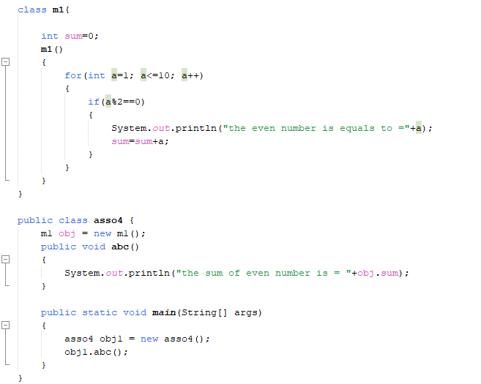

Slide 14
THANKYOU!!

